Slide 1
« Aide »

Slide 2
Introduction
Android: ne pas mettre de majuscules dans les noms d’images

Slide 3
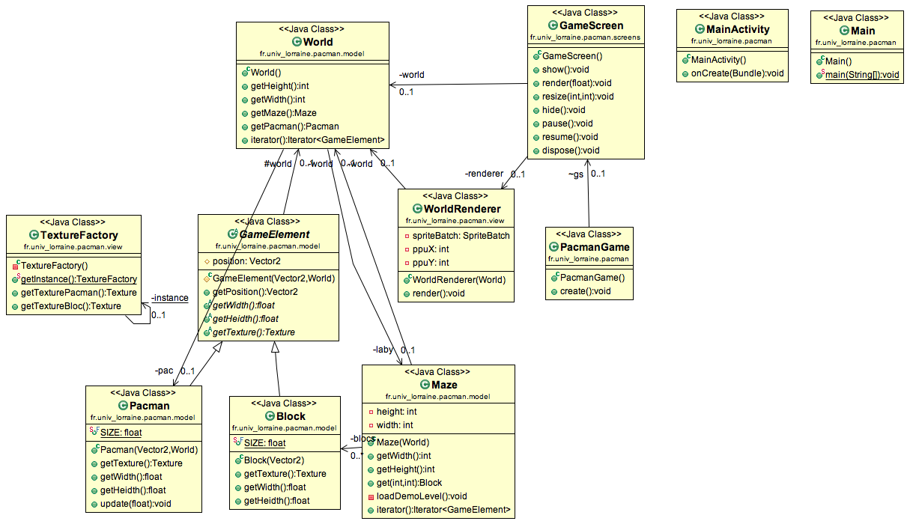
UML de départ

Slide 4
View : TextureFactory
…
public class TextureFactory
{
static private TextureFactory _instance = null;
private TextureFactory()
{
…
}
static public void reset()
{
_instance = null;
}
static public TextureFactory getInstance()
{
if (_instance == null)
_instance = new TextureFactory();
return _instance;
}
…
}

Slide 5
View : TextureFactory
…
public class TextureFactory
{
…
private HashMap<Class<?>, Texture> _textures;
private TextureFactory()
{
_textures = new HashMap<Class<?>, Texture>();
_textures.put(Pacman.class, new Texture(Gdx.files.internal("images/pacman.png")));
_textures.put(Block.class, new Texture(Gdx.files.internal("images/bloc.png")));
}
static public void reset()
{
_instance = null;
}
static public TextureFactory getInstance()
{
if (_instance == null)
_instance = new TextureFactory();
return _instance;
}
…
}

Slide 6
View : WorldRenderer
…
public class WorldRenderer {
private World world;
private SpriteBatch spriteBatch;
private float ppuX, ppuY;
public WorldRenderer(World world) {
this.world = world;
this.spriteBatch = new SpriteBatch();
}
public void render(float delta) {
…
}
public void setPpuX(float ppuX) {
this.ppuX = ppuX;
}
public void setPpuY(float ppuY) {
this.ppuY = ppuY;
}
}

Slide 7
View : WorldRenderer
…
public class WorldRenderer {
…
public void render(float delta) {
this.spriteBatch.begin();
for (GameElement element : this.world) {
this.spriteBatch.draw(
TextureFactory.getInstance().getTexture(element.getClass()),
element.getPosition().x * ppuX,
element.getPosition().y * ppuY,
element.getWidth() * ppuX,
element.getHeight() * ppuY
);
}
this.spriteBatch.end();
}
}

Slide 8
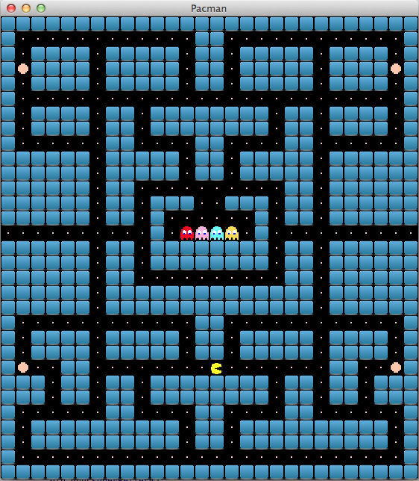
Model : Maze
…
public class Maze …
{
/* 0 : mur, 1 : vide, 2 : intersection, 3 : barriere fantomes */
private int[][] _laby1 = new int[][] {
{0, 0, 0, 0, 0, 0, 0, 0, 0, 0, 0, 0, 0, 0, 0, 0, 0, 0, 0, 0, 0, 0, 0, 0, 0, 0, 0, 0},
{0, 1, 1, 1, 1, 1, 2, 1, 1, 1, 1, 1, 1, 0, 0, 1, 1, 1, 1, 1, 1, 2, 1, 1, 1, 1, 1, 0},
{0, 1, 0, 0, 0, 0, 1, 0, 0, 0, 0, 0, 1, 0, 0, 1, 0, 0, 0, 0, 0, 1, 0, 0, 0, 0, 1, 0},
{0, 1, 0, 0, 0, 0, 1, 0, 0, 0, 0, 0, 1, 0, 0, 1, 0, 0, 0, 0, 0, 1, 0, 0, 0, 0, 1, 0},
{0, 1, 0, 0, 0, 0, 1, 0, 0, 0, 0, 0, 1, 0, 0, 1, 0, 0, 0, 0, 0, 1, 0, 0, 0, 0, 1, 0},
{0, 2, 1, 1, 1, 1, 2, 1, 1, 2, 1, 1, 2, 1, 1, 2, 1, 1, 2, 1, 1, 2, 1, 1, 1, 1, 2, 0},
{0, 1, 0, 0, 0, 0, 1, 0, 0, 1, 0, 0, 0, 0, 0, 0, 0, 0, 1, 0, 0, 1, 0, 0, 0, 0, 1, 0},
{0, 1, 0, 0, 0, 0, 1, 0, 0, 1, 0, 0, 0, 0, 0, 0, 0, 0, 1, 0, 0, 1, 0, 0, 0, 0, 1, 0},
{0, 1, 1, 1, 1, 1, 2, 0, 0, 1, 1, 1, 1, 0, 0, 1, 1, 1, 1, 0, 0, 2, 1, 1, 1, 1, 1, 0},
{0, 0, 0, 0, 0, 0, 1, 0, 0, 0, 0, 0, 1, 0, 0, 1, 0, 0, 0, 0, 0, 1, 0, 0, 0, 0, 0, 0},
{0, 0, 0, 0, 0, 0, 1, 0, 0, 0, 0, 0, 1, 0, 0, 1, 0, 0, 0, 0, 0, 1, 0, 0, 0, 0, 0, 0},
{0, 0, 0, 0, 0, 0, 1, 0, 0, 1, 1, 1, 1, 1, 1, 1, 1, 1, 1, 0, 0, 1, 0, 0, 0, 0, 0, 0},
{0, 0, 0, 0, 0, 0, 1, 0, 0, 1, 0, 0, 0, 3, 3, 0, 0, 0, 1, 0, 0, 1, 0, 0, 0, 0, 0, 0},
{0, 0, 0, 0, 0, 0, 1, 0, 0, 1, 0, 1, 1, 1, 1, 1, 1, 0, 1, 0, 0, 1, 0, 0, 0, 0, 0, 0},
{1, 1, 1, 1, 1, 1, 2, 1, 1, 1, 0, 1, 1, 1, 1, 1, 1, 0, 1, 1, 1, 2, 1, 1, 1, 1, 1, 1},
{0, 0, 0, 0, 0, 0, 1, 0, 0, 1, 0, 0, 0, 0, 0, 0, 0, 0, 1, 0, 0, 1, 0, 0, 0, 0, 0, 0},
{0, 0, 0, 0, 0, 0, 1, 0, 0, 1, 0, 0, 0, 0, 0, 0, 0, 0, 1, 0, 0, 1, 0, 0, 0, 0, 0, 0},
{0, 0, 0, 0, 0, 0, 1, 0, 0, 2, 1, 1, 1, 1, 1, 1, 1, 1, 2, 0, 0, 1, 0, 0, 0, 0, 0, 0},
{0, 0, 0, 0, 0, 0, 1, 0, 0, 1, 0, 0, 0, 0, 0, 0, 0, 0, 1, 0, 0, 1, 0, 0, 0, 0, 0, 0},
{0, 0, 0, 0, 0, 0, 1, 0, 0, 1, 0, 0, 0, 0, 0, 0, 0, 0, 1, 0, 0, 1, 0, 0, 0, 0, 0, 0},
{0, 1, 1, 1, 1, 1, 2, 1, 1, 2, 1, 1, 1, 0, 0, 1, 1, 1, 2, 1, 1, 2, 1, 1, 1, 1, 1, 0},
{0, 1, 0, 0, 0, 0, 1, 0, 0, 0, 0, 0, 1, 0, 0, 1, 0, 0, 0, 0, 0, 1, 0, 0, 0, 0, 1, 0},
{0, 1, 0, 0, 0, 0, 1, 0, 0, 0, 0, 0, 1, 0, 0, 1, 0, 0, 0, 0, 0, 1, 0, 0, 0, 0, 1, 0},
{0, 1, 1, 1, 0, 0, 2, 1, 1, 2, 1, 1, 1, 1, 1, 1, 1, 1, 2, 1, 1, 2, 0, 0, 1, 1, 1, 0},
{0, 0, 0, 1, 0, 0, 1, 0, 0, 1, 0, 0, 0, 0, 0, 0, 0, 0, 1, 0, 0, 1, 0, 0, 1, 0, 0, 0},
{0, 0, 0, 1, 0, 0, 1, 0, 0, 1, 0, 0, 0, 0, 0, 0, 0, 0, 1, 0, 0, 1, 0, 0, 1, 0, 0, 0},
{0, 1, 1, 2, 1, 1, 1, 0, 0, 1, 1, 1, 1, 0, 0, 1, 1, 1, 1, 0, 0, 1, 1, 1, 1, 1, 1, 0},
{0, 1, 0, 0, 0, 0, 0, 0, 0, 0, 0, 0, 1, 0, 0, 1, 0, 0, 0, 0, 0, 0, 0, 0, 0, 0, 1, 0},
{0, 1, 0, 0, 0, 0, 0, 0, 0, 0, 0, 0, 1, 0, 0, 1, 0, 0, 0, 0, 0, 0, 0, 0, 0, 0, 1, 0},
{0, 1, 1, 1, 1, 1, 1, 1, 1, 1, 1, 1, 2, 1, 1, 2, 1, 1, 1, 1, 1, 1, 1, 1, 1, 1, 1, 0},
{0, 0, 0, 0, 0, 0, 0, 0, 0, 0, 0, 0, 0, 0, 0, 0, 0, 0, 0, 0, 0, 0, 0, 0, 0, 0, 0, 0}
};
…
}

Slide 9
Model : Maze
…
package fr.univ_lorraine.pacman.model;
import java.util.Iterator;
import com.badlogic.gdx.math.Vector2;
import com.badlogic.gdx.utils.Array;
public class Maze …
{
private World _world;
private final int _height;
private final int width;
public Maze(World w)
{
_world = w;
this.init ();
}
public int getHeight() { return _height; }
public int getWidth() { return _width; }
}

Slide 10
Model : Maze
…
public class Maze …
{
…
private GameElement[][] _laby2;
…
private void init ()
{
this._height = _laby1.length;
this._width = _laby1[0].length;
this._laby2 = new GameElement[this._height][this._width];
int x = 0,y = 0;
for(int[] t : _laby1) {
for(int elementType : t) {
GameElement element = MazeCOR.getCOR ().build (
this.world,
elementType,
x,
y);
this.maze[x][y] = element;
y = (++y % this.width);
}
x++;
}
}
public GameElement get(int x, int y) { return this._laby2[x][y]; }
}

Slide 11
Model : Maze
…
public class MazeIterator implements Iterator<GameElement> {
private Maze _maze;
int _i, _j;
public MazeIterator(Maze maze) { this._maze = maze; _i = _j = 0; }
@Override
public boolean hasNext() { return (i < this.maze.getHeight()) && (j < this.maze.getWidth()); }
@Override
public GameElement next() {
if(!this.hasNext()) throw new NoSuchElementException("No more game elements");
GameElement gameElement;
do {
gameElement = this.maze.get(i,j);
j = (j + 1) % this.maze.getWidth();
if(j == 0)
i++;
} while(gameElement == null
&& this.hasNext());
return gameElement;
}
@Override public void remove() { … } }
}
…
public class Maze implements Iterable<GameElement> {
@Override
public Iterator<GameElement> iterator() {
return new MazeIterator(this);
}

Slide 12
Model : GameElement
…
public abstract class GameElement
{
protected Vector2 _pos;
protected World _world;
public GameElement(Vector2 pos, World w)
{
_position = pos;
_world = w;
}
public Vector2 getPosition()
{
return position;
}
}

Slide 13
Model : PacMan
…
public class Pacman extends GameElement {
public Pacman(Vector2 position, World world) {
super(position,world);
}
}
…
public class Block extends GameElement {
public Block(Vector2 position, World world) {
super(position,world);
}
}

Slide 14
Model : World
…
public class World implements Iterable<GameElement>
{
private Pacman _pacman;
private Maze _maze;
public World() {
this._pacman = new Pacman(new Vector2(1,1), this);
this._maze = new Maze(this);
}
public Maze getMaze() { return this._maze; }
public int getWidth() { return this._maze.getWidth(); }
public int getHeight() { return this.maze.getHeight(); }
public Pacman getPacman() { return this._pacman; }
@Override
public Iterator<GameElement> iterator() {
return new WorldIterator(this);
}
}

Slide 15
Model : World
…
public class WorldIterator implements Iterator<GameElement>
{
private World _world;
private Iterator<GameElement> _mazeIterator;
int _i;
public WorldIterator(World world) {
this._world = world;
this._mazeIterator = this._world.getMaze().iterator();
this._i = 0; /* 0 = maze, 1 = pacman */
}
@Override
public boolean hasNext() {
return (this.i < 1);
}
@Override
public GameElement next() {
if((_i == 0) {
if (!this.mazeIterator.hasNext())
_i = 1; // on passe à Pacman
}
else _i++;
GameElement res;
switch(this.i) {
case 0 : return this.mazeIterator.next();
case 1 : return this.world.getPacman();
default : … /* erreur */
}
}
@Override
public void remove() { … }
}

Slide 16
Model : Game
…
public class PacmanGame extends Game {
@Override
public void create() {
this.setScreen(new GameScreen());
}
}

Slide 17
Model : Screen
…
public class GameScreen implements Screen {
private World _world;
private WorldRenderer _worldRenderer;
public GameScreen() {
this._world = new World();
this._worldRenderer = new WorldRenderer(this.world);
}
public World getWorld() { return this._world; }
@Override
public void render(float delta) {
Gdx.gl.glClear(GL10.GL_COLOR_BUFFER_BIT);
Gdx.gl.glClearColor(0, 0, 0, 0);
this._worldRenderer.render(delta);
}
@Override
public void resize(int width, int height) {
this._worldRenderer.setPpuX(width/(float)this._world.getWidth());
this_.worldRenderer.setPpuY(height/(float)this._world.getHeight());
}
@Override public void show() { TextureFactory.reset(); }
@Override public void hide() { // TODO Auto-generated method stub }
@Override public void pause() { // TODO Auto-generated method stub }
@Override public void resume() { // TODO Auto-generated method stub }
@Override public void dispose() { // TODO Auto-generated method stub }
}

Slide 18
La suite …
Permettre le déplacement des objets
Action de l’utilisateur
Pacman
Automatiquement
Fantômes
Discussion

